Slide 1

Google Android Developer Virtual Internship
by
C.SAMREEN
Roll No. 224G1A3283
Department of Computer Science and Engineering (Data Science)
Srinivasa Ramanujan Institute of Technology
(Affiliated to JNTUA & Approved by AICTE) (Accredited by NAAC with ‘A’ Grade & Accredited by NBA (EEE, ECE & CSE)
Rotarypuram Village, B K Samudram Mandal, Ananthapuramu – 515701.
2024 - 2025

Slide 2

Contents
Introduction
Modules
Modules Explanation
Real Time applications
Conclusion
Reference
GitHub Link

Slide 3
Introduction
Google Central to Android’s development is Google, offering core software, services,
and updates. The Google Play Store serves as the official app distribution platform,
granting users access to millions of applications. The user interface of Android is
tailored for touch gestures , featuring a customizable home screen and support for
widgets, ensuring an interactive and intuitive experience.
From Edu skills Foundation, AICTE launches a Virtual Internship on Google Android
Developer Virtual Internship.
The main of this is to gain insights on Android applications.
Google states that “Android apps can be written using Kotlin, Java, C++ languages”
using the Android Software Development Kit(SDK),while using other languages is also
possible.

Slide 4
Modules
Your first Android app
Building App UI
Display lists and use Material Design
Navigation and app architecture
Connect to Internet
Data Persistence
Work Manager
Views and Compose

Slide 5
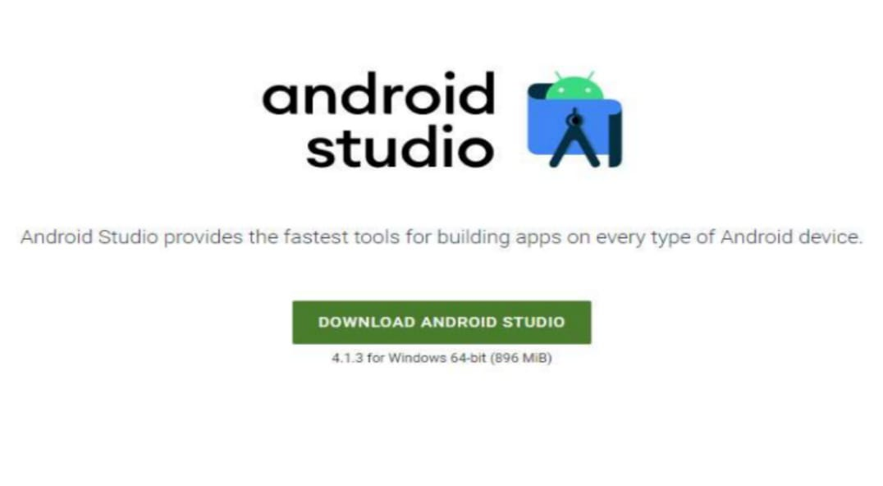
Your first Android App
Android Studio Installation

Slide 6
Your first Android App
The module describes about the android and requirements of android. The requirements Kotlin programming language, setting up the android studio and describes building a Kotlin, a modern and concise programming language, has emerged as a preferred choice for Android app development. Endorsed by Google, Kotlin offers a seamless integration with existing java code and brings a host of features like null safety, concise syntax, and improved code readability. Its expressive and pragmatic nature accelerates development, making it an excellent fit for Android projects. As the official language for Android app development since increases developer productivity, reduces boilerplate code, and contributes to building robust, efficient, and more maintainable applications.
Android applications Configuration of JDK & IDE
https://www.oracle.com/java/technologies/downloads/#jdk17-windows
https://developer.android.com/studio Operations Perspective

Slide 7
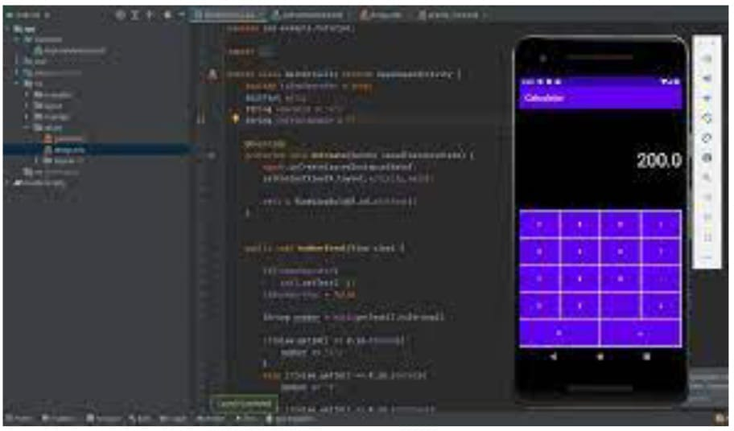
Building App UI
The app is designed to compute tips based on user input, demonstrating fundamental principles of user interface design and state management. Throughout the development process, we explore techniques for capturing user input, dynamically updating the UI, and managing the application’s state to ensure a seamless and responsive user experience. By the end of this module, learners will have gained valuable insights into creating interactive UIs and handling states, providing a solid foundation for developing user friendly applications.

Slide 8
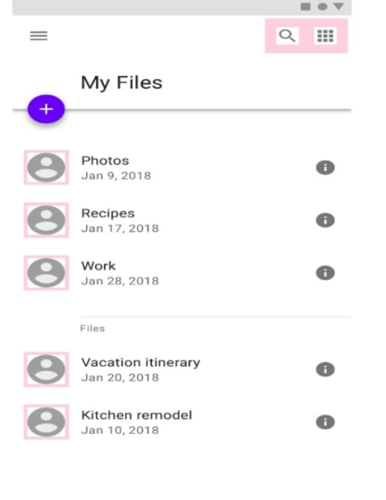
Display lists and use Material Design
In this module, we explore the creation of an app using Compose that showcases as scrollable list containing both text and images. By following the provided guidelines, developers will gain hands-on experience in leveraging Compose, a modern Android UI toolkit, to design and implement dynamic interfaces. The app's functionality includes the seamless integration of text and images within a scrollable layout, demonstrating essential techniques for creating engaging and visually appealing user experiences.

Slide 9
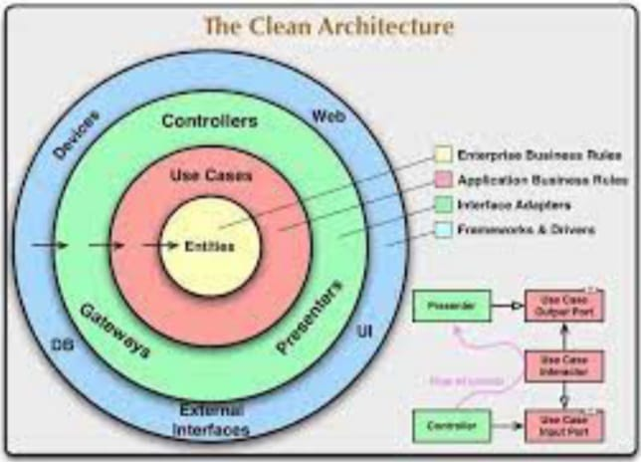
Navigation and app architecture
This module provides nuanced insights into the hierarchical structure and design principles conducive to an integrated user journey. Additionally, developers will gain profound knowledge on the effective passing and management of data between screens, emphasizing efficiency and maintaining a resilient architecture, This resource is tailored to help developers master the advanced functionalities of the Navigation component, enabling the creation of dynamic, interconnected applications that respond dynamically to user interactions.

Slide 10
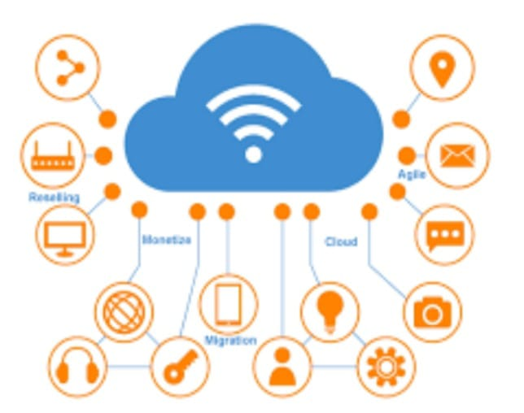
Connect to Internet
Connecting to the internet is a fundamental aspect of modern application development, enabling communication between devices and servers. Here’s a concise overview of key concepts when establishing internet connections in software.
Network Permission: Declare the necessary network permissions in the Android Manifest. xml file. This is the crucial for the app to access the internet. You typically include the <uses-permission> element with appropriate permissions like <uses-permission android: name=“android. permission. INTERNET”/>. This permission allows the app to create network sockets for sending and receiving the data over the internet.
Network Requests: Use either HTTP or HTTPS protocols to initiate network requests from your application to remote servers. This is typically done using the following methods:
Http URL Connection: This is a basic API provided by java for sending HTTP requests and receiving responses. It’s relatively low-level but offers fine-grained control over the request and response process.
Http Client: Historically, Http client was a commonly used library for sending HTTP requests. However, it has been deprecated in recent Android versions in favour of newer and more efficient API’s like Http URL Connection or third-party libraries like Ok Http.

Slide 11
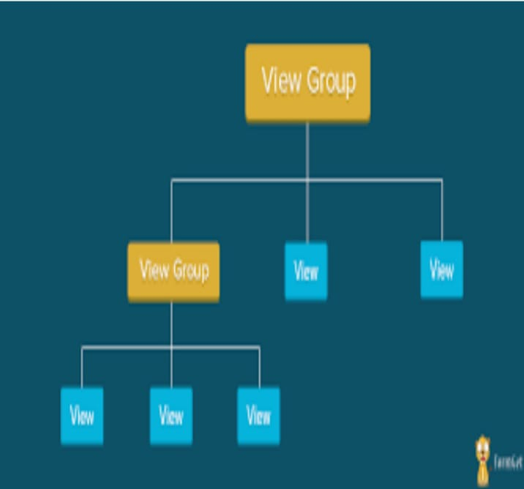
Data Persistence
Data persistence in software development refers to the process of storing and retrieving the data to and from a persistent storage medium , such as a database or file system. It is a crucial aspect of creating robust and user-friendly applications. There are several methods for achieving data persistence in Android applications.
Structured Query Language:
SQL, or Structured Query Language is a powerful domain specific language designed for managing and manipulating relational databases. It provides a standardized way to interact with the databases, allowing users to perform operations such as querying, updating, inserting, deleting the data. SQL is used to define and manipulate the structure of relational databases, create and modify tables, and retrieve information based on specified criteria.
Storing and Accessing Data Using Keys With Data Store:
Data store, a component of Android Jetpack, represents a contemporary approach to managing and persisting key-value-pairs, introducing a more robust and type-safe alternative to the traditional Shared Preferences System. Operating on the foundational concept of key-value storage, Data Store ensures that each piece of data is associated with a unique identifier, facilitating straightforward retrieval and updates as needed.

Slide 12
Work Manager
Google's Android Work Manager is a powerful API within the Android Jetpack library designed to simplify and manage background tasks in Android applications. It addresses the need for executing tasks that continue running even when the app is not in the foreground or if the device restarts. Here's a brief summary of Work Manager's key features:
Background Task Management:
Work Manager allows developers to schedule and manage tasks that run in the background, such as data syncing, periodic updates, or content downloads.
Persistent Execution: Tasks scheduled with Work Manager persist across device reboots and app closures, ensuring reliable execution even in challenging conditions.
Simplified API:
Work Manager provides a simplified and consistent API, abstracting away the complexity of managing background tasks. It is built on top of

Slide 13
Views and Compose
A View is a fundamental element for any user interface (or design) in android. The View is a base class for all UI components in android. For example, the Edit Text class is used to accept the input from users in android apps, which isa subclass of View. Following are the some of common View subclasses that will be used in android applications.
Text View
Edit View
Button
Check Box

Slide 14
Real Time Applications
Ride-Sharing Apps(e.g., Door Dash, Grubhub)
Weather Apps with Real Time Updates(e.g., AccuWeather)
Home Security Apps with Live Camera Feeds(e.g., Nest, Ring)
Emergency Services Apps(e.g., SOS Apps)
Health and Fitness Apps with GPS(e.g., Strava, Run keeper)
Live Location Tracking(e.g., Google Maps)
Real-time IoT control apps
Real-time Collaborative Apps(e.g., Google Docs, Sheets)
Health Monitoring Apps(e.g., Samsung Health, monitor heart rate, step counts, biometrics)

Slide 15
Conclusion
Enrolling in Google's Android development course provides a concise yet comprehensive journey into the world of mobile app creation. With Google’s expertise in developing the Android platform, learners can expect a focused curriculum covering essential topics like programming languages, the Android SDK, and API integration. The course's hands-on approach ensures a practical understanding of building robust applications, aligning with industry standards. Google's direct involvement assures access to up-to-date content, reflecting the latest trends and tools in Android development. Completing this course not only equips individuals with the skills necessary for app creation but also stands as a valuable endorsement from a leading authority in the mobile technology landscape.

Slide 16
References
[1] https://developer.android.com/courses/android-basics-compose/course
[2] https://internship.aicte-india.org

Slide 17
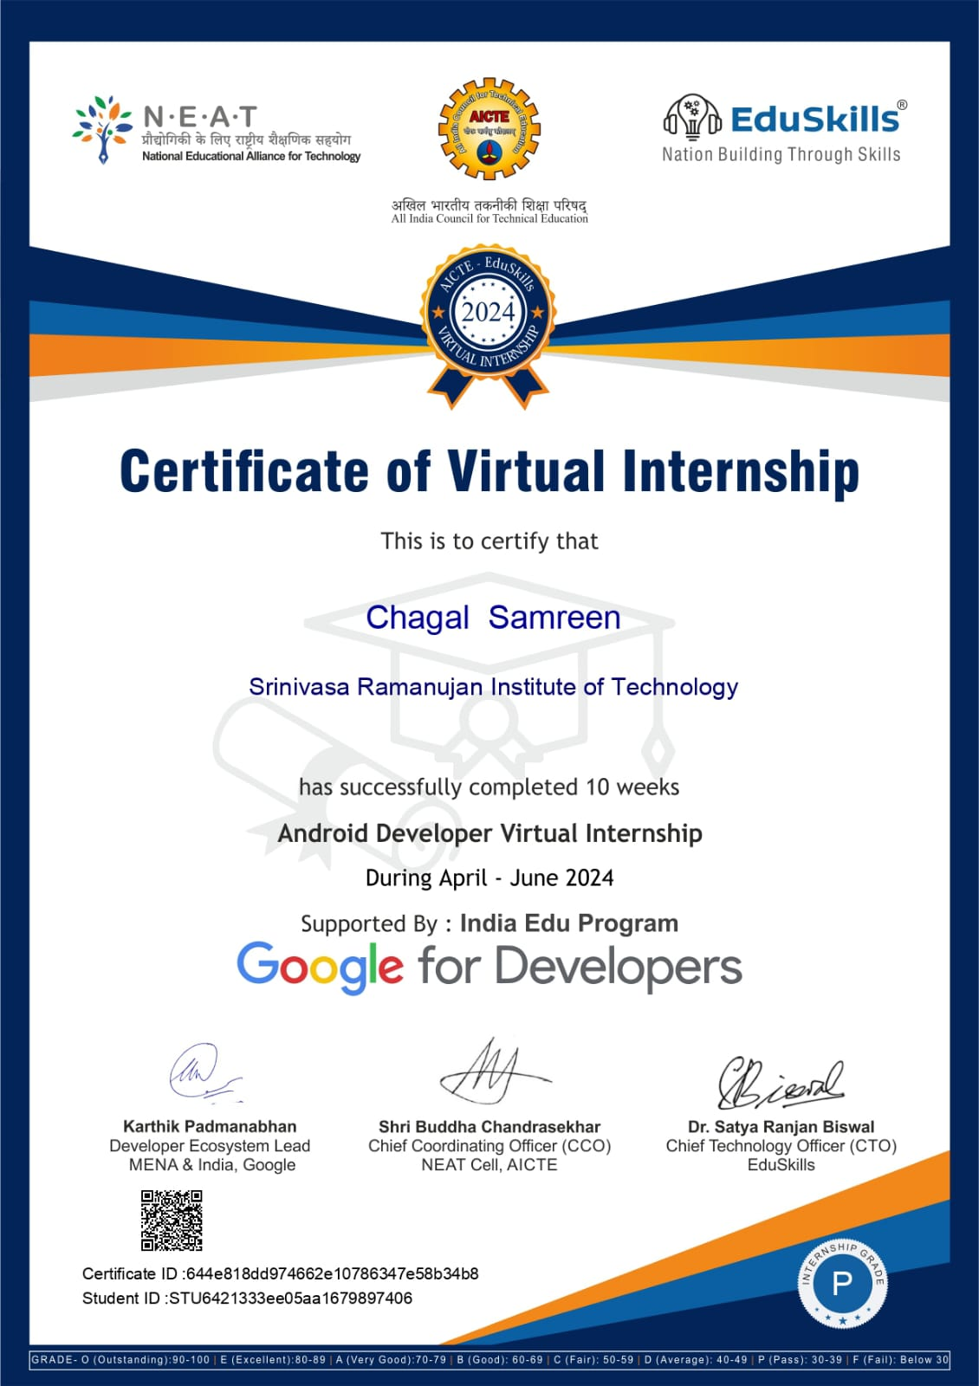
Internship Certificate

Slide 18
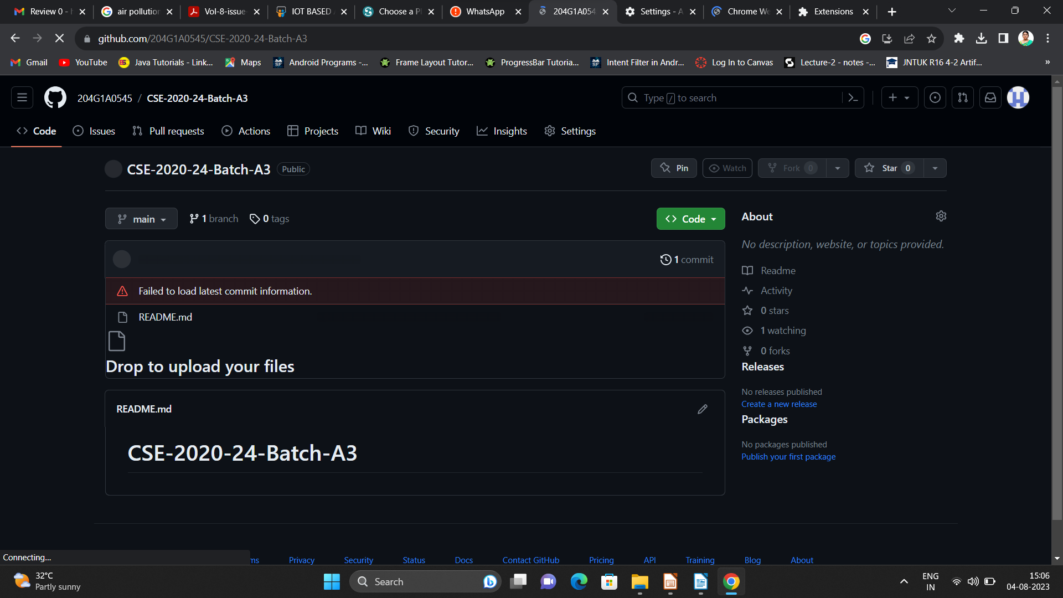

Git Hub Dashboard
Repository Name Like: Summer Internship - I
Under that include document, presentation and Certificate(Pdf).

Slide 19
Thank You!!!

